Slide 1
Lecture #13: External Sorting
CME2002 Data Organization and Management
Dr.Adil Alpkocak

Slide 2
Why Sort?
A classic problem in computer science!
Data requested in sorted order
e.g., find students in increasing GPA order
Sorting is first step in bulk loading B+ tree index.
Sorting useful for eliminating duplicate copies in a collection of records (Why?)
Sort-merge join algorithm involves sorting.
Problem: sort 1Gb of data with 1Mb of RAM.
why not virtual memory?
Notes:
4

Slide 3
Creating Initial Sorted Segments
Whenever a file does not fit entirely into memory:
First Stage (Sorting) : divide file into segments & sort each one separately.
Second Stage(Merging): merge sorted segments
Each stage involves reading & writing the file at least once:
sorting w/one disk drive takes at least 4*Tx
sorting w/two disk drives takes at least 2*Tx (reading & writing time is overlapped)

Slide 4
2-Way Sort: Requires 3 Buffers
Pass 1: Read a page, sort it, write it.
only one buffer page is used
Pass 2, 3, …, etc.:
three buffer pages used.
INPUT 1
OUTPUT
INPUT 2
Main memory buffers
Disk
Disk
Notes:
5

Slide 5
Two-Way External Merge Sort
Each pass we read + write each page in file.
N pages in the file => the number of passes
So total cost is:
Idea: Divide and conquer: sort subfiles and merge
3,4
6,2
9,4
8,7
5,6
3,1
2
Input file
PASS 0
3,4
2,6
4,9
7,8
5,6
1,3
2
1-page runs
PASS 1
2,3
4,7
1,3
2-page runs
4,6
8,9
5,6
2
PASS 2
2,3
4,4
1,2
4-page runs
6,7
3,5
8,9
6
PASS 3
1,2
2,3
3,4
8-page runs
4,5
6,6
7,8
9
Notes:
6

Slide 6
General External Merge Sort
More than 3 buffer pages. How can we utilize them?
To sort a file with N pages using B buffer pages:
Pass 0: use B buffer pages. Produce sorted runs of B pages each.
Pass 2, …, etc.: merge B-1 runs.
INPUT 1
. . .
INPUT 2
. . .
. . .
OUTPUT
INPUT B-1
Disk
Disk
B Main memory buffers
Notes:
7

Slide 7
Cost of External Merge Sort
Number of passes:
Cost = 2N * (# of passes)
E.g., with 5 buffer pages, to sort 108 page file:
Pass 0: = 22 sorted runs of 5 pages each
Pass 1: = 6 sorted runs of 20 pages each
Pass 2: 2 sorted runs, 80 pages and 28 pages
Pass 3: Sorted file of 108 pages
Notes:
8

Slide 8
Number of Passes of External Sort
Notes:
9

Slide 9
Double Buffering
To reduce wait time for I/O request to complete, can prefetch into `shadow block’.
Potentially, more passes; in practice, most files still sorted in 2-3 passes.
INPUT 1
INPUT 1'
INPUT 2
OUTPUT
INPUT 2'
OUTPUT'
b
Disk
INPUT k
block size
Disk
INPUT k'
B main memory buffers, k-way merge

Slide 10
Heapsort with One Disk Drive
Most optimal method for external sorting with one disk drive
Because input & output is overlapped, so only the I/O time needs to be counted. Sorting becomes free! (This is not the case for other internal sorting routines such as quicksort, bubblesort, etc.)
Creates the initial sorted segments which are the size of the available memory.

Slide 11
Overlapping Heapsort with I/O
Heap has two meanings:
a pile file, or unsorted file
priority queue
A priority queue is a complete binary tree, where each node contains a record with a key value which is smaller than the keys in its two children.
Root is the smallest key of all the records in the tree
But keys are not totally in order

Slide 12
Complete Binary Trees
A complete binary tree has a tree in which
all leaves are on two levels: kth level and (k+1)th level,
the leaves on the bottommost level are in the leftmost positions in that level.
A complete binary tree is easy to model with an array:
We arrange the nodes of the tree in level order.
The height is floor(log n), where n is the # nodes in the tree.
The children of the ith element in the array are in the 2ith & (2i+1)st elements of the array.

Slide 13
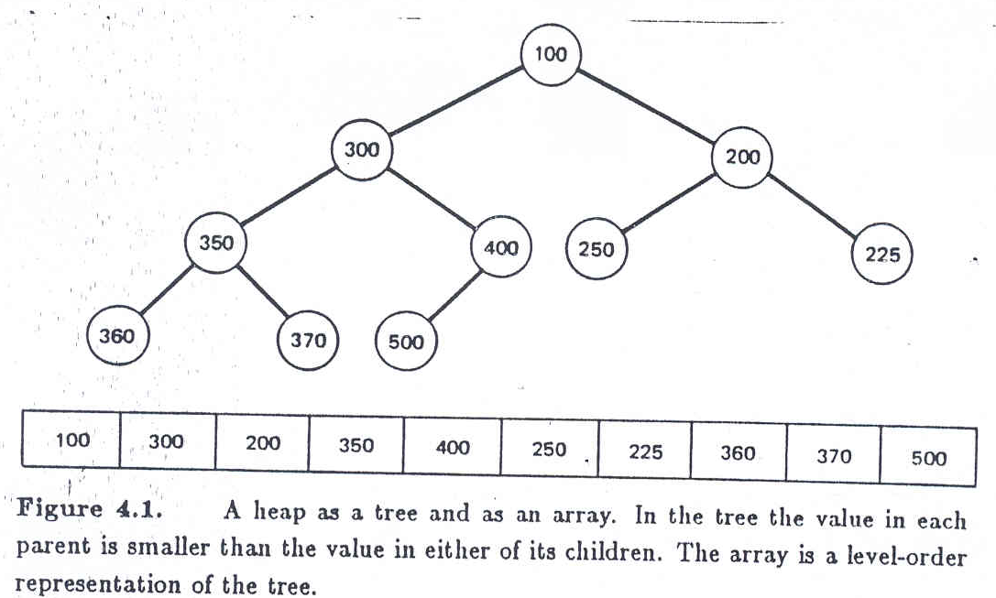
Heap
The children of the ith element in the array are in the 2ith & (2i+1)st elements of the array.

Slide 14
The Idea of Heapsort
1st Stage: Insertion into a heap
read in records from current input buffer
Put the new record at the end of the array.
This correspond to the rightmost node on the bottom level of the tree
If new record’s key is smaller than its parent’s key, then exchange new record with its parent, recursively up the heap.
(# comparisons & exchanges <= log n, where n is the # records that have already been read into memory)
Goto step 1 if there is empty space in memory.
2nd Stage: Output sorted segments

Slide 15
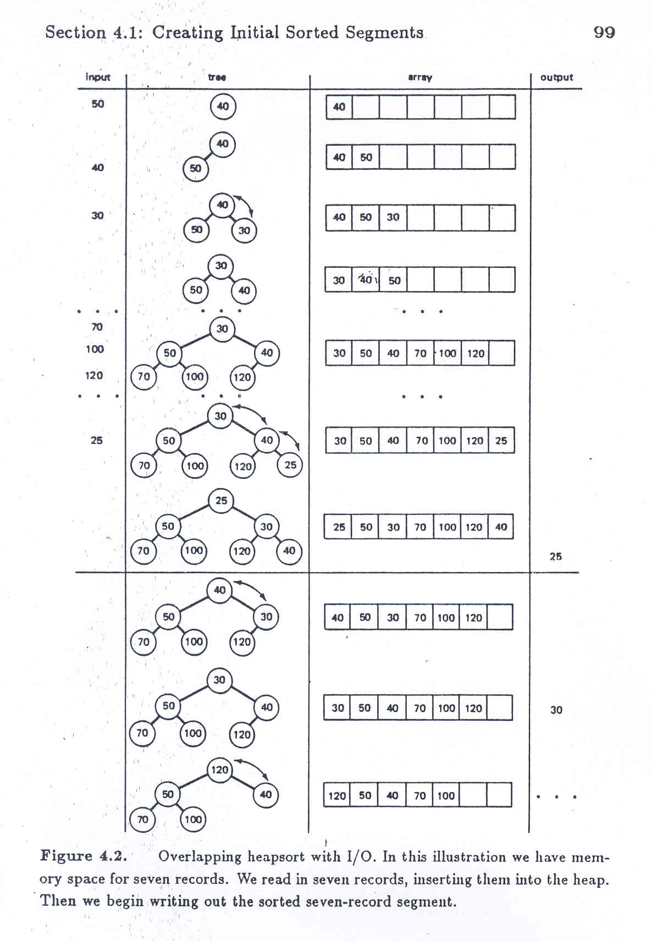
Insertion into a heap

Slide 16
2nd Stage: Output Sorted Segment
WHILE more records exist not written to disk DO
Move the root record into the output buffer
Move last record of the array (rightmost bottom record) in the root position.
If the new root’s key is greater than its two children, exchange it with the smaller child. Repeat this, until the tree becomes a heap.

Slide 17
2nd Stage: Output Sorted Segments

Slide 18
2nd Stage: Output Sorted Segment
This is an O(log n) operation, where n is the # records left in the tree.
It can be a great extent to be overlapped with the writing of the sorted segment.
10MB of data contains (10 MB / 2400)= 4166.6 blocks
T_{R(10MB)} = 4166.6 * 0.84 = 3500 msec
So, time for creating the initial sorted segments
2b * ebt
output b1
output b2
output b3
output b4
write b1
write b2
write b3
write b4
0
0.84
1.68
2.52
3.36
time

Slide 19
Sorting with Replacement Selection w/2 Disks
Produces sorted segments twice the size of memory.
It takes only one sequential reading time. Reading, writing, and sorting all overlap.
Requires two disk drives.
Read b1
Read b2
Read b3
Read b4
Read b5
…
sort b1
sort b2
sort b3
sort b4
…
write b1
write b2
write b3
…
0
0.84
1.68
2.52
3.36
time

Slide 20
Replacement Selection w/2 Disks
Algorithm:
A heap is constructed from the first read segment.
Using heapsort, smallest records that completes a block are emitted.
A new block is read in:
New records with keys smaller than those of records already written out is put into a second heap in memory.
Others are inserted into the first heap as usual and smallest record at root position is moved to the output buffer.
The empty position (root position) in the first heap are filled with the smallest element of the second heap. (Exchanges may be needed)

Slide 21
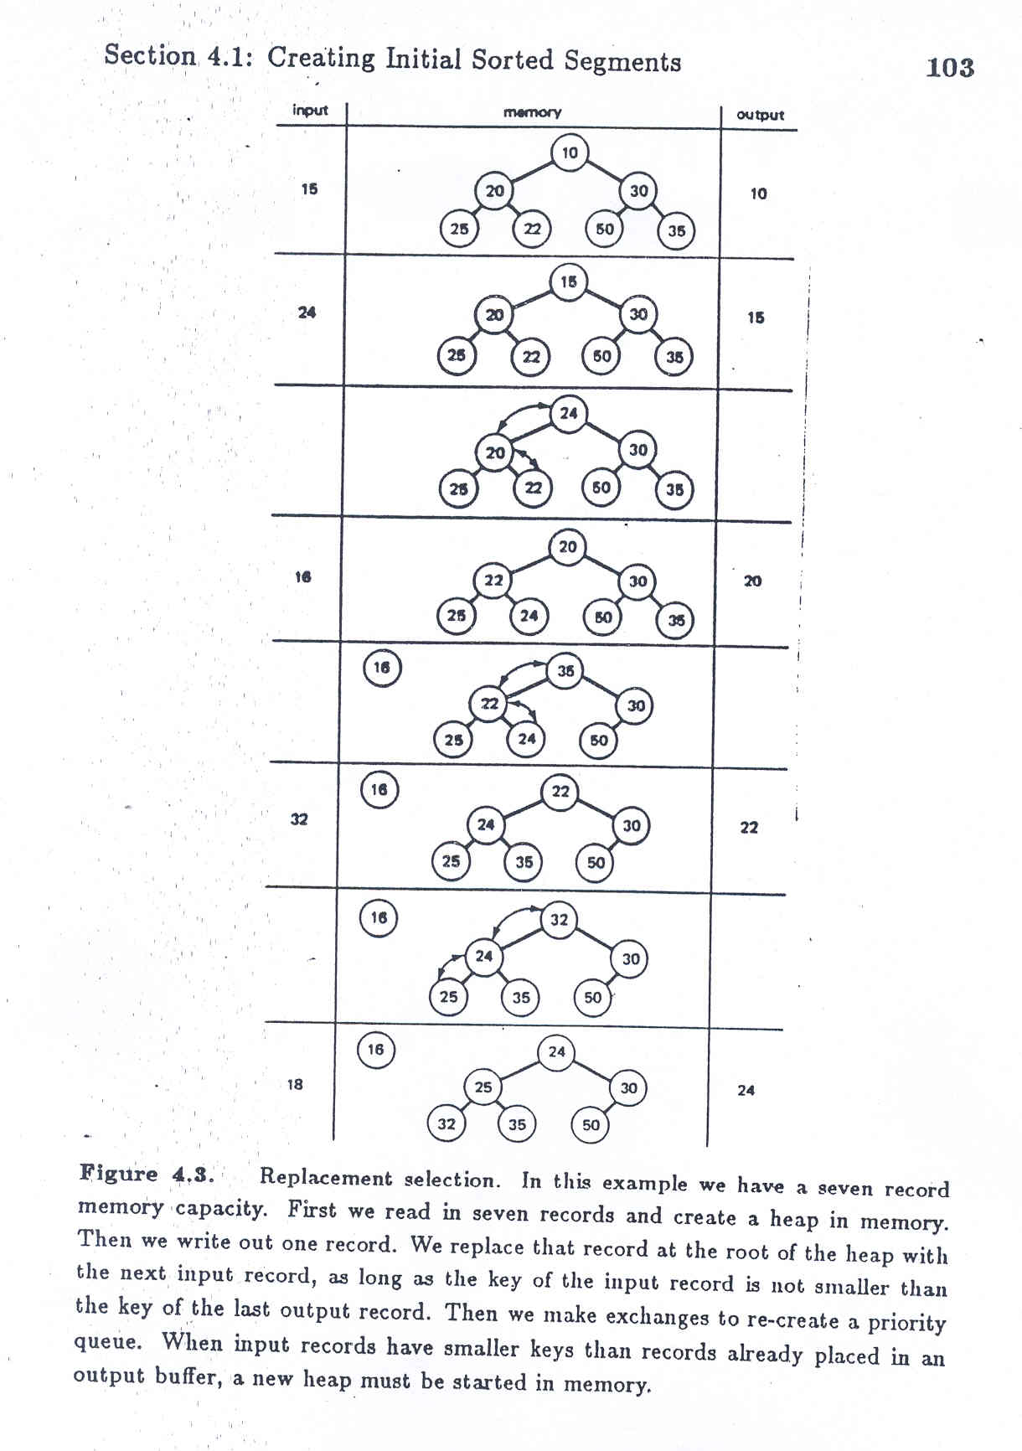

Slide 22
Analysis:
We can overlap i/o with internal processing:
We can both insert a record and output a record in the time. (it previously took just to do output of one record.)

Slide 23
Extreme Cases:
In case the keys of incoming records are mostly smaller than the keys of the records which have already been emitted:
After some time, the new heap in memory may become larger than the old one.
In this case we may not be able to overlap I/O (both usual input and usual output must take place)
In case records are partially sorted in ascending order:
It will take longer before the new heap dominates the old heap. The output segment will be very large.
For random input, output segments are twice the size of memory.
if file is partially sorted in the right order, the segments will be longer.
opposite order, shorter

Slide 24
Using Quicksort with Virtual Memory is Slow !
Quicksort is an O(n log n) sorting method
good if whole file fits into memory
as not good as heapsort, since quicksort cannot overlap I/O
if not, we can write a quicksort program that rely on virtual memory (i.e., as if the whole file fits into memory)
But this does not make sense if (file size) >> (memory size)
A paging policy such as LRU (least recently used) is often used in virtual memory implementation.

Slide 25
I/O for External Merge Sort
… longer runs often means fewer passes!
Actually, do I/O a page at a time
In fact, read a block of pages sequentially!
Suggests we should make each buffer (input/output) be a block of pages.
But this will reduce fan-out during merge passes!
In practice, most files still sorted in 2-3 passes.

Slide 26
Sorting Records!
Sorting has become a blood sport!
Parallel sorting is the name of the game ...
Datamation: Sort 1M records of size 100 bytes
Typical DBMS: 15 minutes
World record: 3.5 seconds
12-CPU SGI machine, 96 disks, 2GB of RAM
http://sortbenchmark.org/
New benchmarks proposed:
Minute Sort: How many can you sort in 1 minute?
Dollar Sort: How many can you sort for $1.00?

Slide 27
Summary
External sorting is important; DBMS may dedicate part of buffer pool for sorting!
External merge sort minimizes disk I/O cost:
Pass 0: Produces sorted runs of size B (# buffer pages). Later passes: merge runs.
# of runs merged at a time depends on B, and block size.
Larger block size means less I/O cost per page.
Larger block size means smaller # runs merged.
In practice, # of runs rarely more than 2 or 3.
Notes:
19

Slide 28
Summary, cont.
Choice of internal sort algorithm may matter:
Quicksort: Quick!
Heap sort: slower (2x), longer runs
The best sorts are wildly fast:
Despite 40+ years of research, It’s still improving!

